Slide 1
Engineered regulatory systems modulate gene expression of human commensals in the gut.

Slide 2
Bacterioides
Gram-negative, obligate anaerobic bacteria, non endospore-forming bacilli
benefit their host by excluding potential pathogens from colonizing the gut
opportunistic human pathogens, causing infections of the peritoneal cavity, gastrointestinal surgery, and appendicitis via abscess formation, inhibiting phagocytosis, and inactivating beta-lactam antibiotics

Slide 3
Inducible promoters are particularly valuable tools because these platforms allow real-time analysis of the contribution of microbiome gene products to community assembly, host physiology, and disease

Slide 4
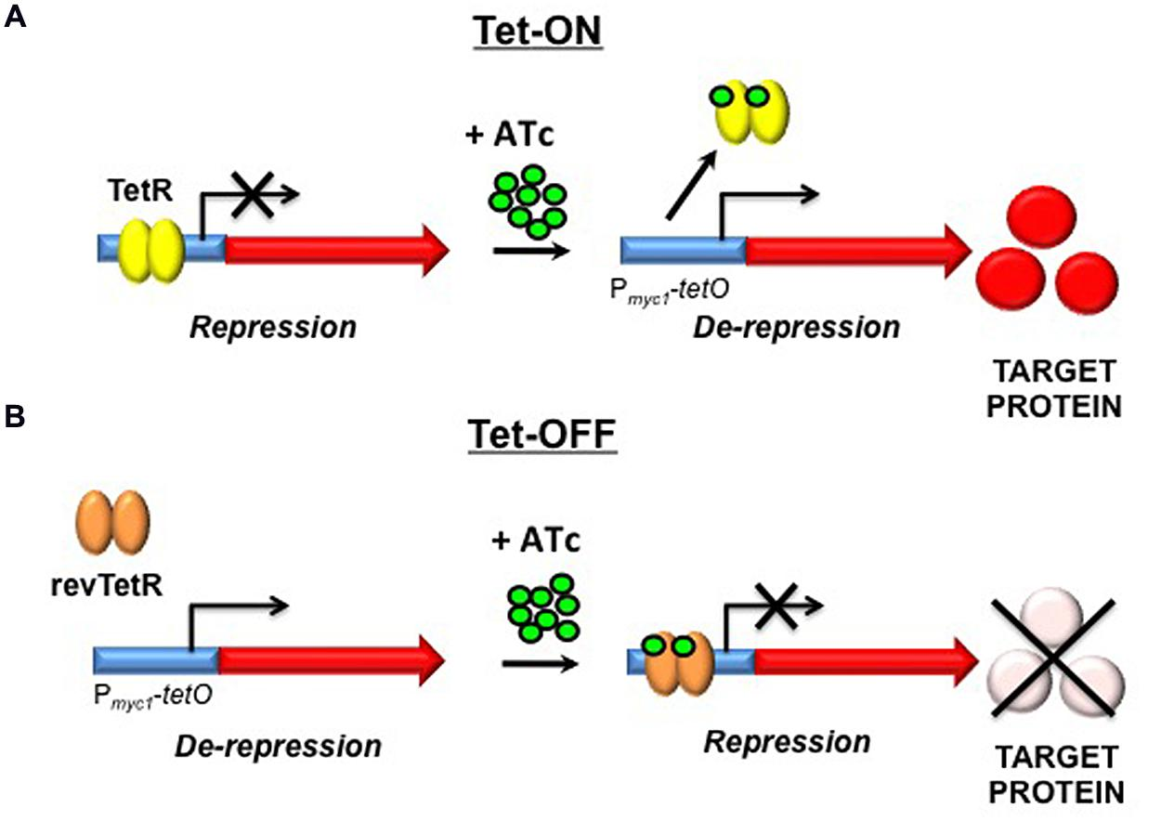
Tetracycline-regulated systems
useful tool for analyzing gene function.
utilize a constitutively expressed repressor, TetR, which binds the tetO operator sequence in the promoter, preventing RNAP from binding DNA and initiating transcription.

Slide 5
a panel of tunable gene expression platforms for diverse human gut Bacteroides. In the OFF state, these systems recapitulate the phenotypes of mutants that lack the target gene entirely. Upon aTC induction, these engineered promoters can individually modulate gene expression up to 9,000-fold, spanning five orders of magnitude across the panel

Slide 6
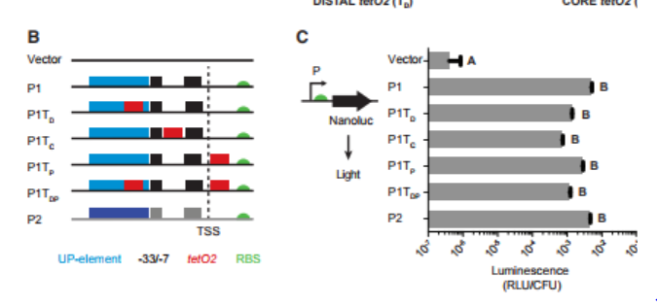
P1 and P2 constitutive promoters and engineered P1 promoters containing tetO2 elements.
Together, these results suggest that tetO2 insertion affects promoter activity, but reporter activity remains 4,200-fold to 16,000-fold above background, depending on operator placement
Notes:
We first created several modified P1 promoters containing the tetO2 operator in each of three locations: upstream of the 33 (distal; P1TD), within the spacer region between the 33 and 7 (core; P1TC), or downstream of the transcription start site (proximal; P1TP) (To first investigate the positional effects of the tetO2 operators on basal gene expression in the absence of the TetR repressor, we fused the native P1 and P2 promoters, and each synthetic promoter, to a standard Bacteroides RBS (GH023) (Wegmann et al., 2013), followed by the NanoLuc luciferase gene as a reporter

Slide 7
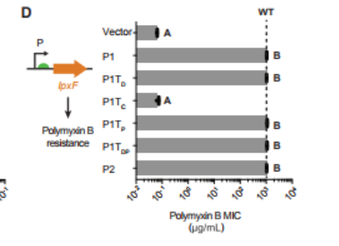
Replaced the NanoLuc reporter with BT1854 (lpxF)
Notes:
To test the function of native Bacteroides genes expressed under the control of these engineered promoters, we replaced the NanoLuc reporter with BT1854 (lpxF). LpxF is a phospholipid phosphatase that determines resistance to cationic antimicrobial peptides

Slide 8
Bt::tetR revealed that, while TetR has no effect on the activity of the native P1 promoter, all of the tetO2-containing promoters exhibit a significant decrease in activity in the presence of TetR

Slide 9
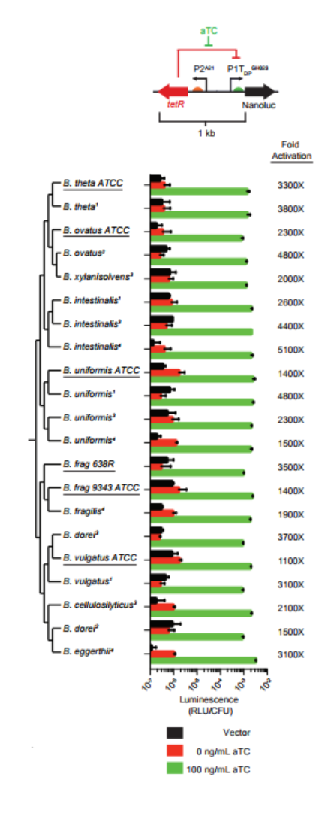
Gene expression control across species
Notes:
To facilitate gene expression control across species, we built a self-contained, 1 kb inducible expression cassette (designated TetR-P1TDP) in which tetR is expressed from the P2A21 promoter and oriented in the opposite direction from P1TDPGH023, thereby providing the ability to artificially regulate gene expression in unmodified strains of multiple species in a single step

Slide 10
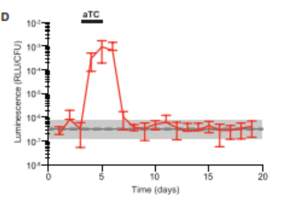
Exogenous Control of Bacteroides Gene Expression in Mice via a Synthetic Inducer

Slide 11
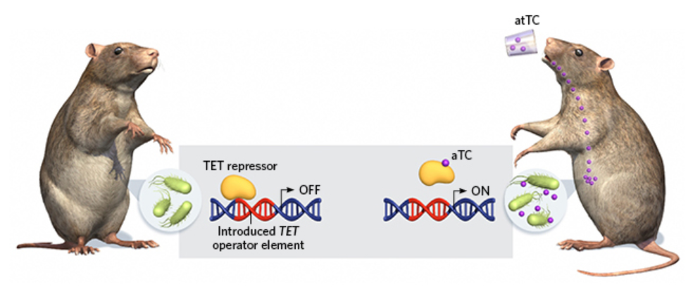
Researchers modified an endogenous Bacteroides promoter sequence to be inducible—it can be turned on or off in mice by adding (right) or omitting (left) anhydrotetracycline (aTC) to the animal’s drinking water. The aTC binds to the TET repressor protein (yellow), thereby preventing its suppression of gene expression.
Notes:
leverage our gut microbes so they can perform tasks,” such as deliver drugs or take physiological measurements

